Slide 1
Contingency Analysis: Associations Between Categorical Variables
Analysis of Biological Data
Chapter 9

Slide 2
We Often Care About Associations
- Does eating chocolate decrease the chance you’ll have a bad day? 🍫
- Does the home team have an advantage? 🏀
- Is the use of “bath salts” associated with cannibalism? 🛁 🧟‍♀️ Probably Not
- Does fertilizing tomatoes increase the chance they set fruit? 🍅
etc…

Slide 3
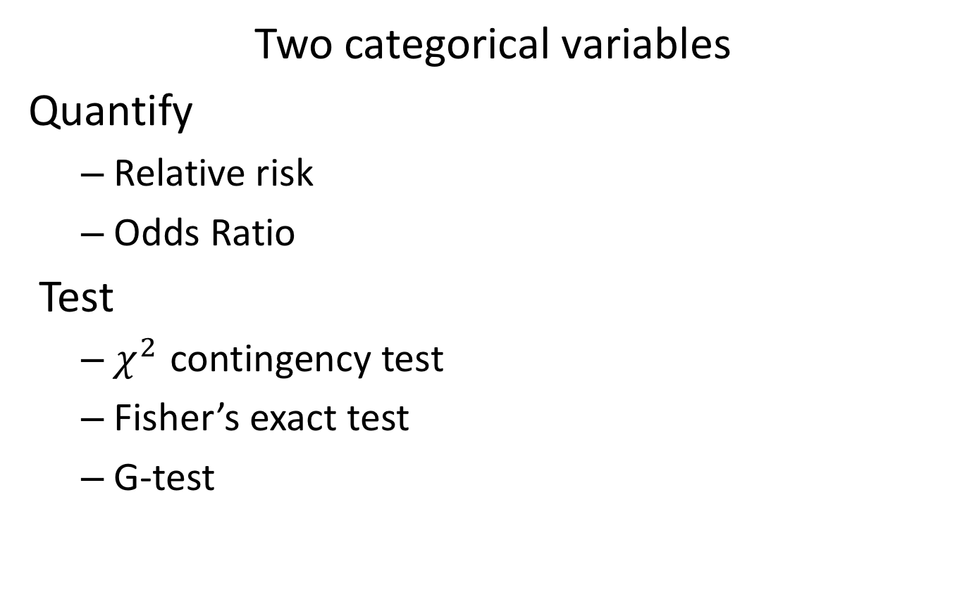
Quantifying & Testing Associations
Two categorical variables
Quantify
Relative risk
Odds Ratio
Test
$χ^{2}$ contingency test
Fisher’s exact test
G-test

Slide 4
Example: Blue Butts Get Birds Bit
Could pigeons with white butts distract and avoid predators to save their tails?
To find our Palleroni et al [Link] followed 203 birds with white or blue butts.
Today, we will learn how to rigorously quantify and test for associations in cases like this.

Slide 5
Quantifying Associations Between Categorical Variables
$$\text{Relative} \text{Risk}\text{ \& }\text{Odds} \text{Ratio}$$

Slide 6
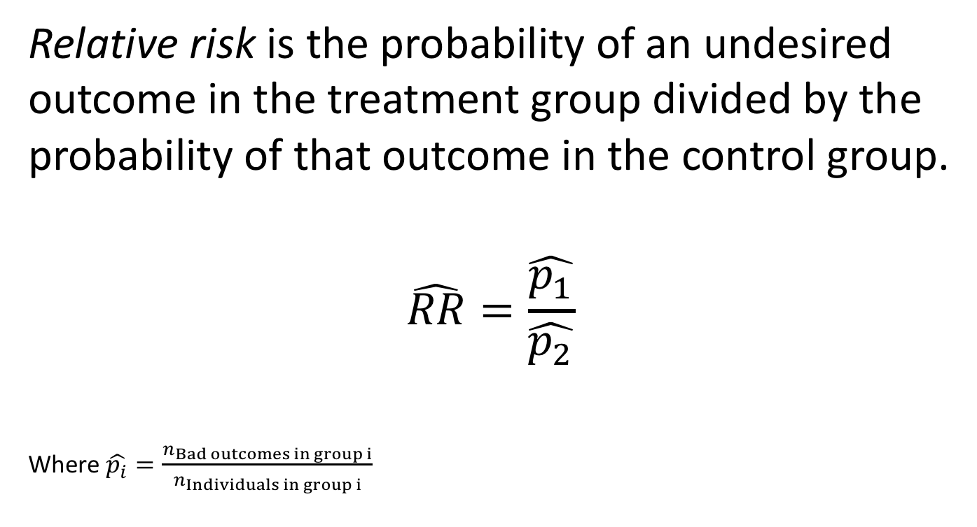
Relative Risk
Relative risk is the probability of an undesired outcome in the treatment group divided by the probability of that outcome in the control group.
$$\hat{RR}=\frac{\hat{p_{1}}}{\hat{p_{2}}}$$
Where $\hat{p_{i}}=\frac{n_{Bad outcomes in group i}}{n_{Individuals in group i}}$

Slide 7
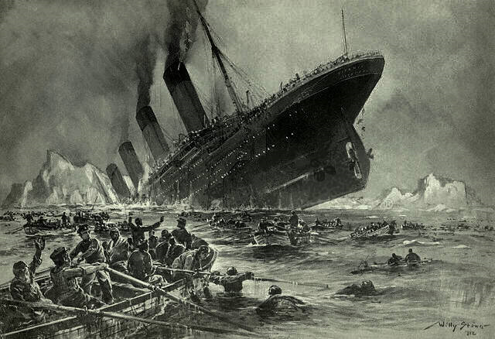
Relative Risk: Titanic Example
Comparing the risk of death for women to men.
https://upload.wikimedia.org/wikipedia/commons/6/6e/St%C3%B6wer_Titanic.jpg

Slide 8
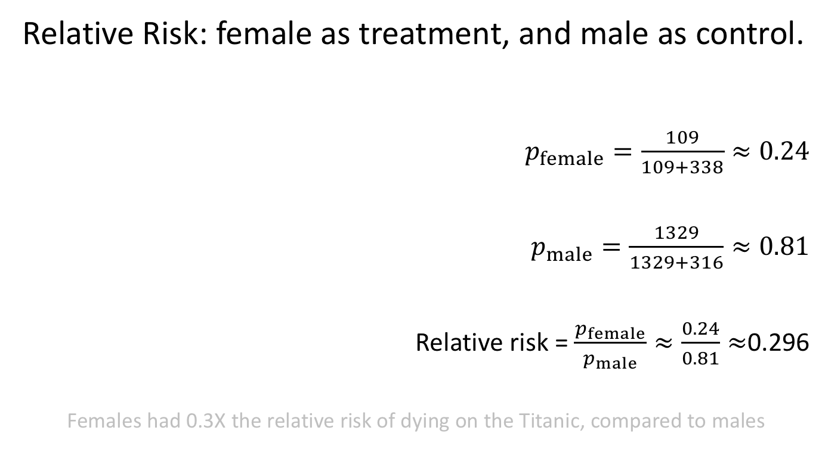
Example: Surviving the Titanic
Relative Risk: female as treatment, and male as control.
$p_{female}=\frac{109}{109+338}≈0.24$
$p_{male}=\frac{1329}{1329+316}≈0.81$
Relative risk = $\frac{p_{female}}{p_{male}}≈\frac{0.24}{0.81}≈$0.296
Females had 0.3X the relative risk of dying on the Titanic, compared to males

Slide 9
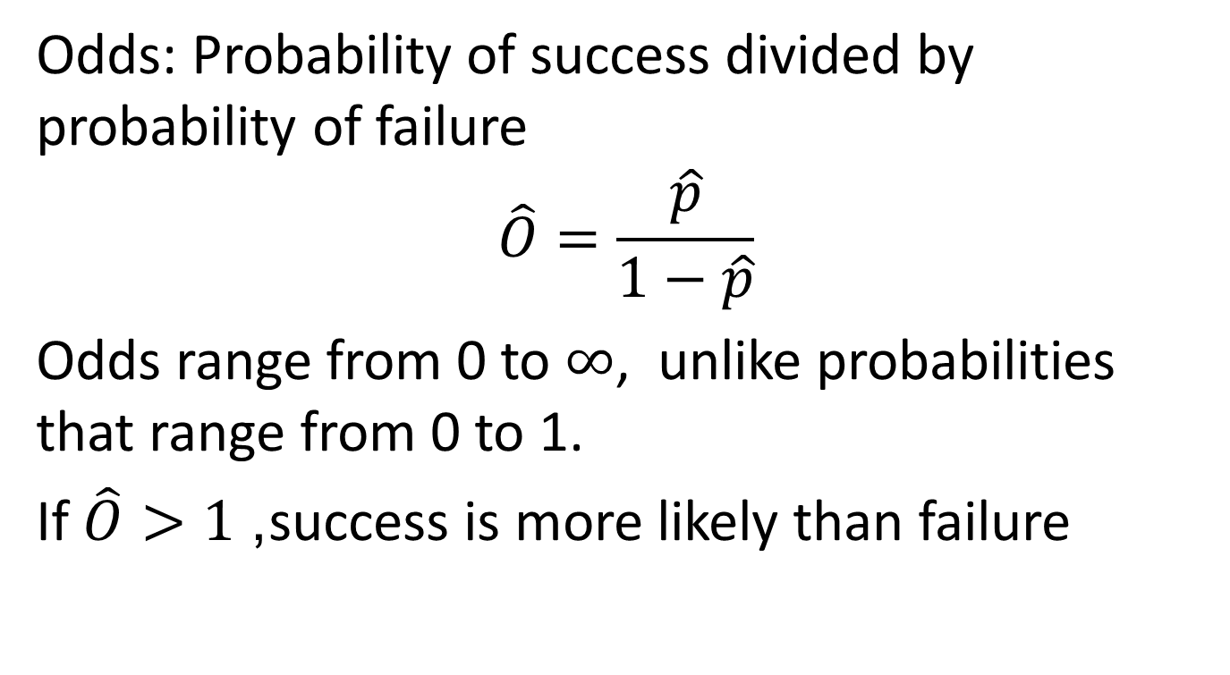
Odds and Odds Ratios
Odds: Probability of success divided by probability of failure
$$\hat{O}=\frac{\hat{p}}{1−\hat{p}}$$
Odds range from 0 to $∞$, unlike probabilities that range from 0 to 1.
If $\hat{O}>1$, success is more likely than failure

Slide 10
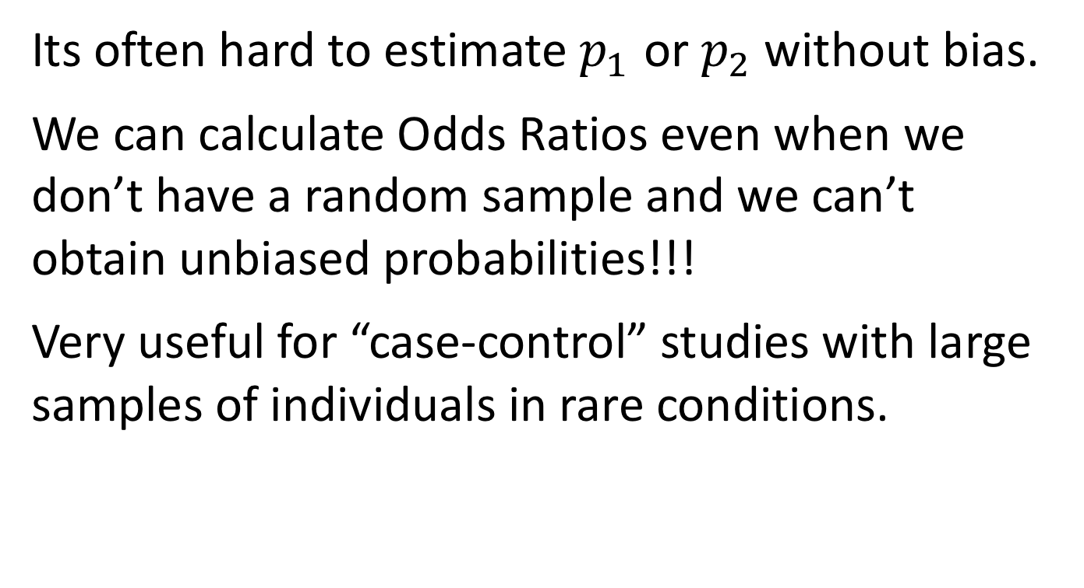
When to Calculate Odds Ratios?
Its often hard to estimate $p_{1}$ or $p_{2}$ without bias.
We can calculate Odds Ratios even when we don’t have a random sample and we can’t obtain unbiased probabilities!!!
Very useful for “case-control” studies with large samples of individuals in rare conditions.

Slide 11
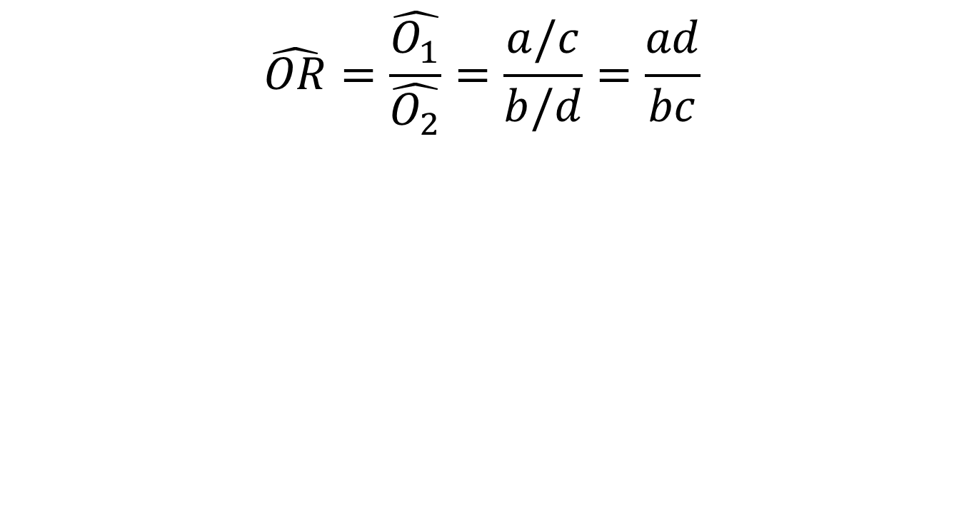
How to Calculate Odds Ratios
$$\hat{OR}=\frac{\hat{O_{1}}}{\hat{O_{2}}}=\frac{a/c}{b/d}=\frac{ad}{bc}$$
 | Treatment | Control
Success | a | b
Failure | c | d

Slide 12
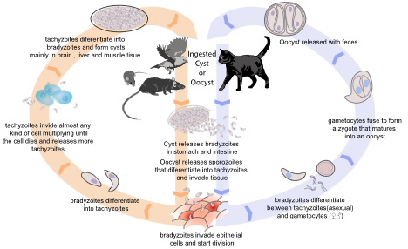
Odds Ratio: Toxoplasma & Car Wrecks
Toxoplasma tricks mice into taking risks so it can find it’s way into cats.
Could it be associated with human risk taking?
To test this, Yereli et al
compared Toxoplasma prevalence in drivers who caused car crashes to prevalence in those who hadn’t.
https://upload.wikimedia.org/wikipedia/commons/7/72/Toxoplasmosis_life_cycle_en.svg

Slide 13
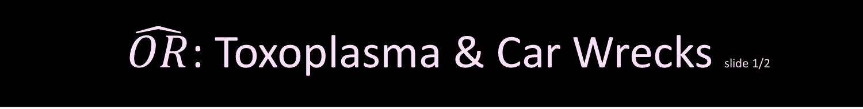
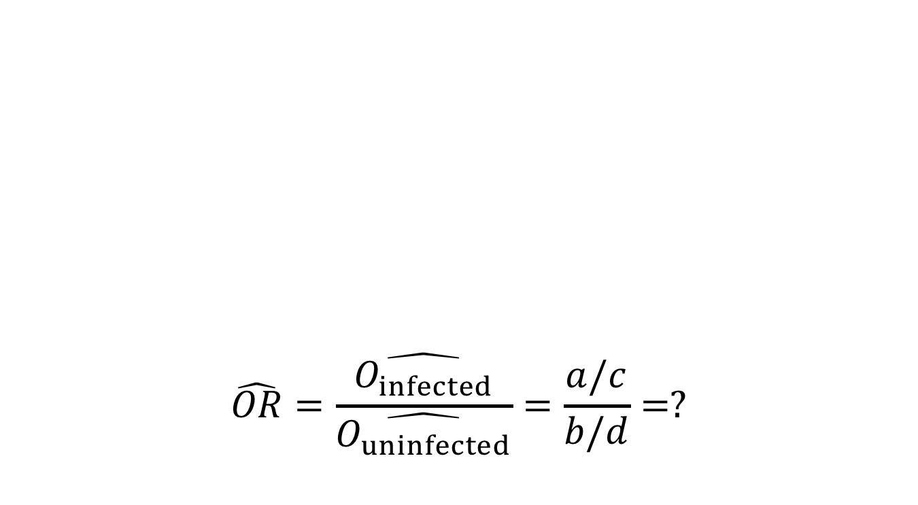
$\hat{OR}$: Toxoplasma & Car Wrecks slide 1/2
$$\hat{OR}=\frac{\hat{O_{infected}}}{\hat{O_{uninfected}}}=\frac{a/c}{b/d}=?$$
 | Infected | Uninfected
Car wreck | a = 61 | b = 124
No wreck | c = 16 | d = 169

Slide 14

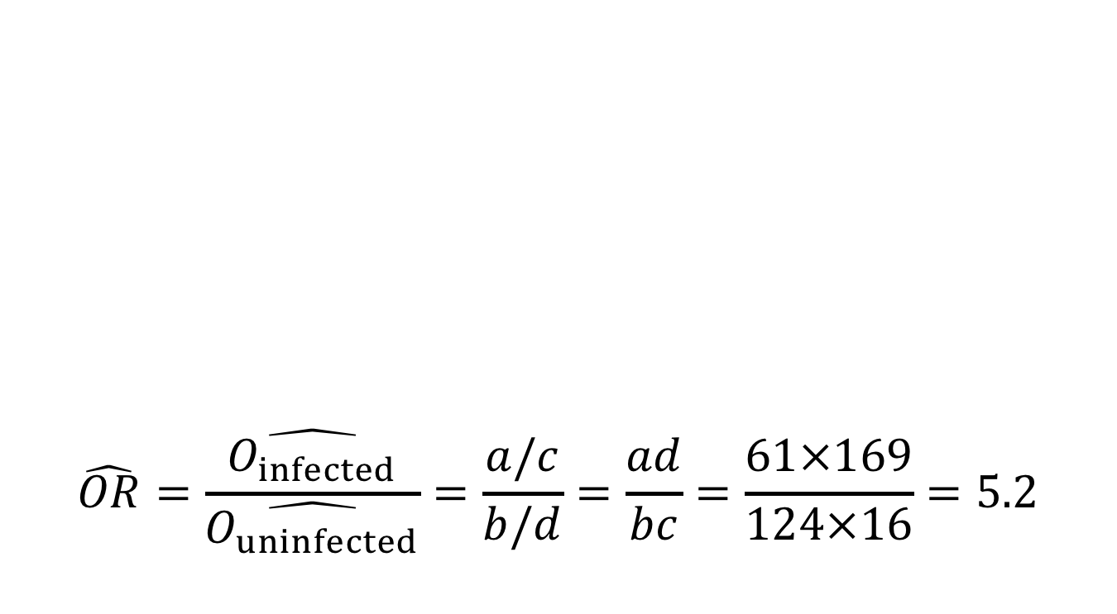
$\hat{OR}$: Toxoplasma & Car Wrecks slide 2/2
$$\hat{OR}=\frac{\hat{O_{infected}}}{\hat{O_{uninfected}}}=\frac{a/c}{b/d}=\frac{ad}{bc}=\frac{61×169}{124×16}=5.2$$
 | Infected | Uninfected
Car wreck | a = 61 | b = 124
No wreck | c = 16 | d = 169

Slide 15
Toxoplasma & Car Wrecks: Summary
We did not know the proportion of people with toxoplasma in car wrecks.
Still, we learned that the odds of being in a car wreck is five times higher if you have toxoplasma than if you do not!

Slide 16
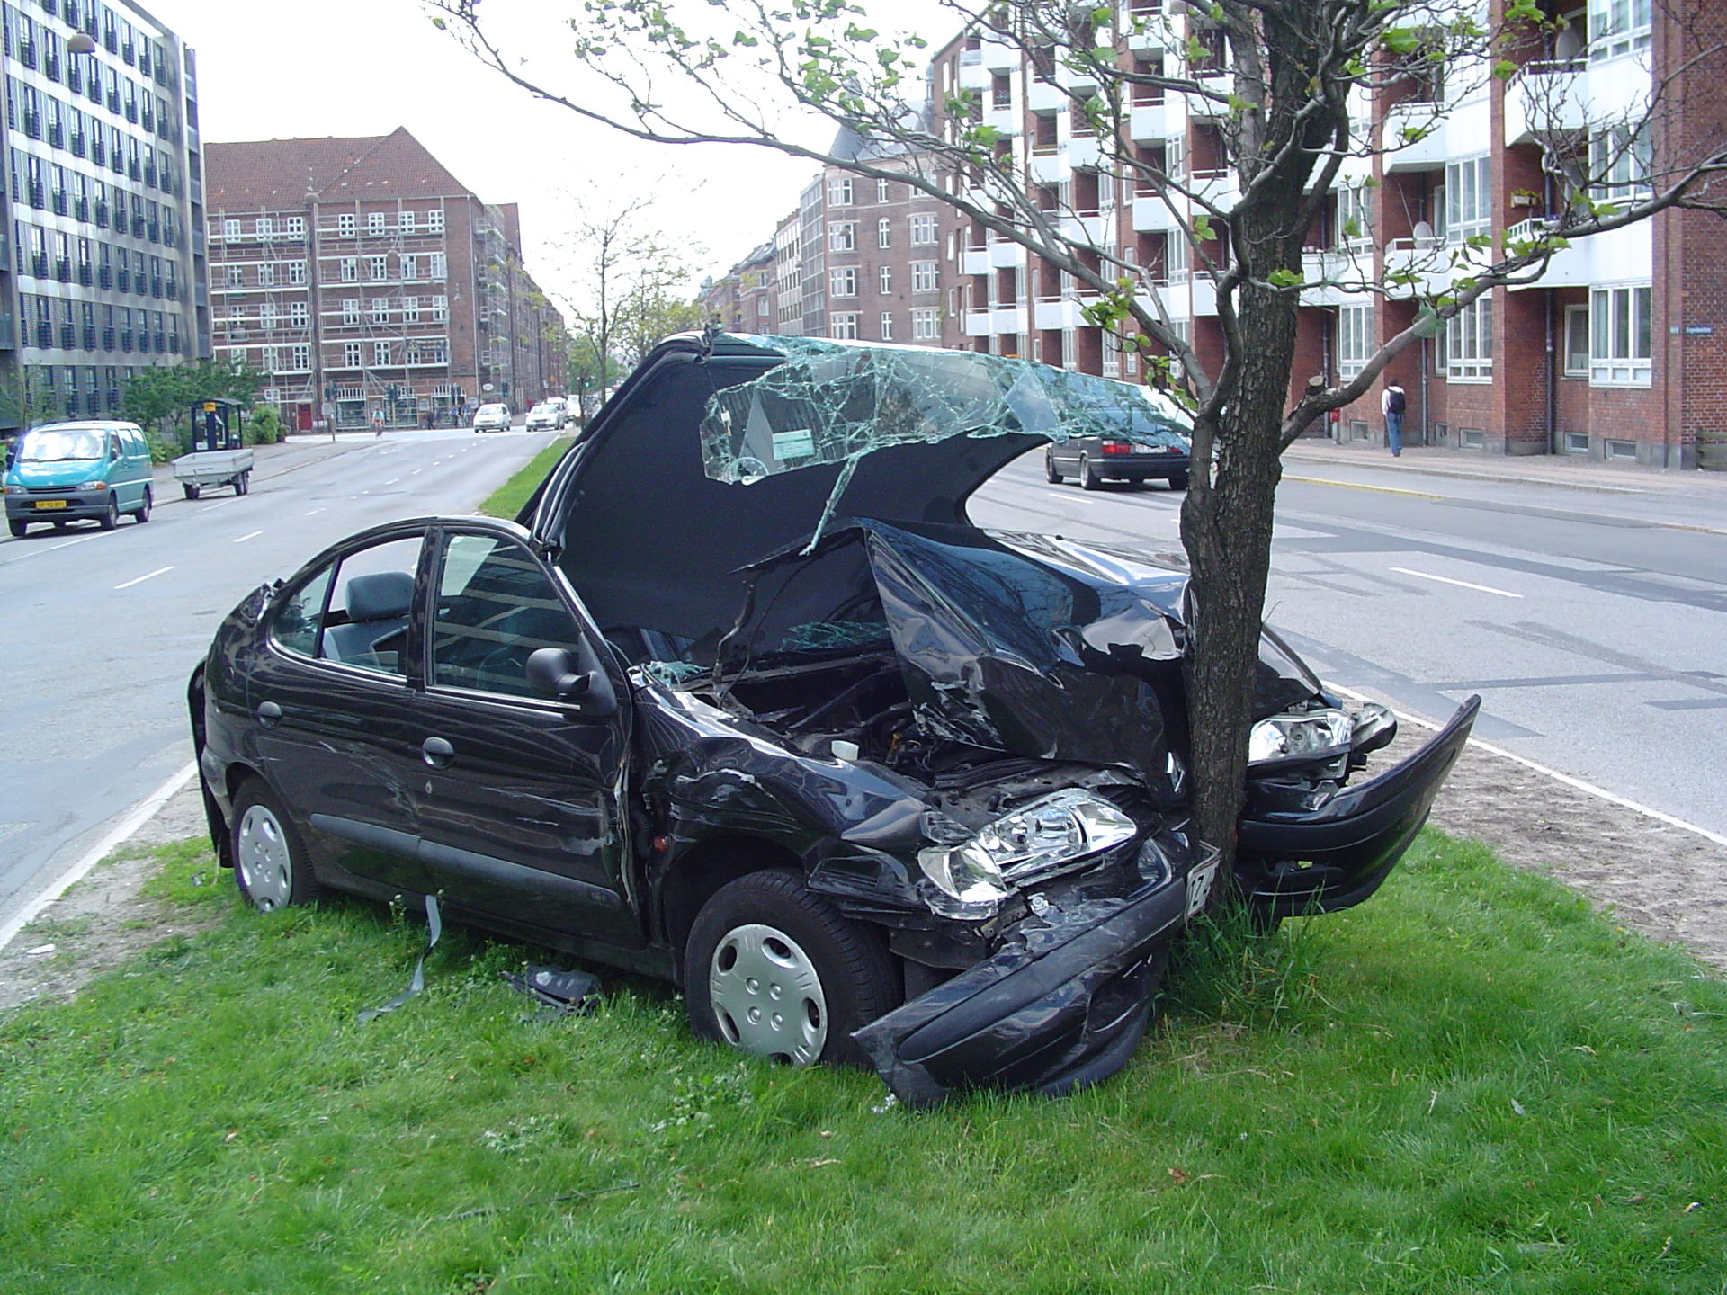
Toxoplasma & Car Wrecks: Uncertainty
We estimate a 5.2-fold increase in the chance of being in a car wreck for people with toxoplasma.
We know that this estimate is uncertain.
We can quantify this uncertainty!!!
https://upload.wikimedia.org/wikipedia/commons/thumb/e/e1/Car_crash_1.jpg/1920px-Car_crash_1.jpg

Slide 17
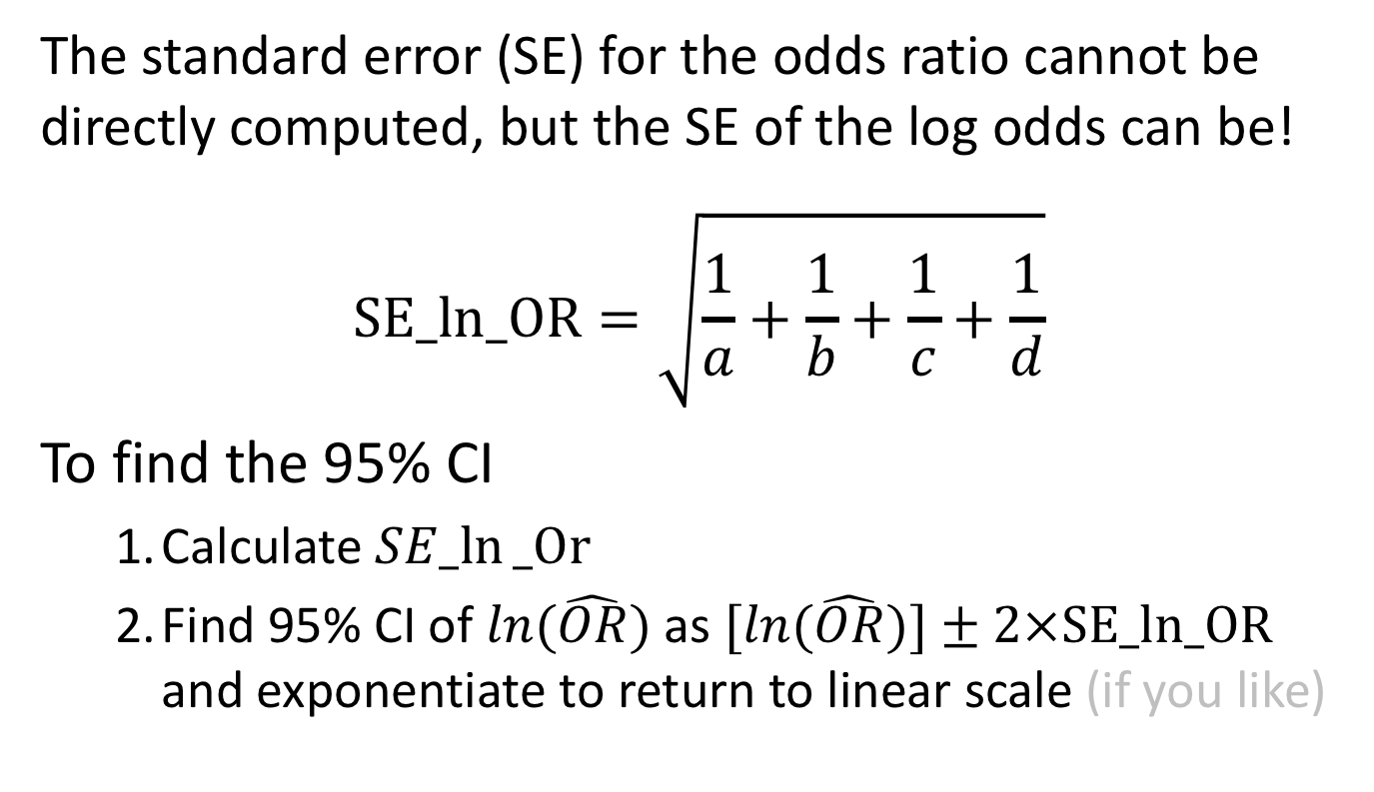
Toxoplasma & Car Wrecks: 95% CI slide 1/4
The standard error (SE) for the odds ratio cannot be directly computed, but the SE of the log odds can be!
$$SE_ln_OR=\sqrt[ ]{\frac{1}{a}+\frac{1}{b}+\frac{1}{c}+\frac{1}{d}}$$
To find the 95% CI
Calculate $SE_ln⁡_Or$
Find 95% CI of $ln(\hat{OR})$as $[ln(\hat{OR})]±2×SE_ln_OR$ and exponentiate to return to linear scale (if you like)

Slide 18
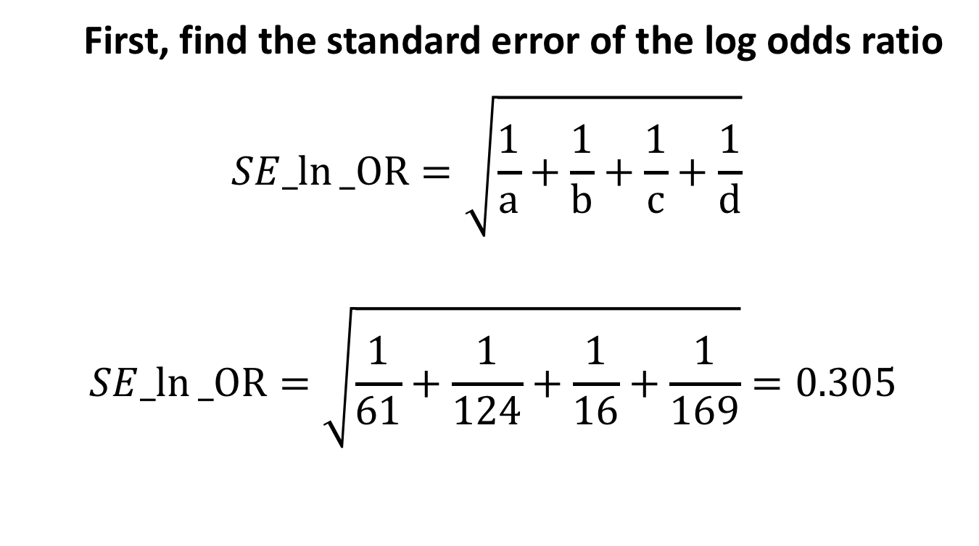
Toxoplasma & Car Wrecks: 95% CI slide 2/4
First, find the standard error of the log odds ratio
$$SE_ln⁡_OR=\sqrt[ ]{\frac{1}{a}+\frac{1}{b}+\frac{1}{c}+\frac{1}{d}}$$
$$SE_ln⁡_OR=\sqrt[ ]{\frac{1}{61}+\frac{1}{124}+\frac{1}{16}+\frac{1}{169}}=0.305$$

Slide 19
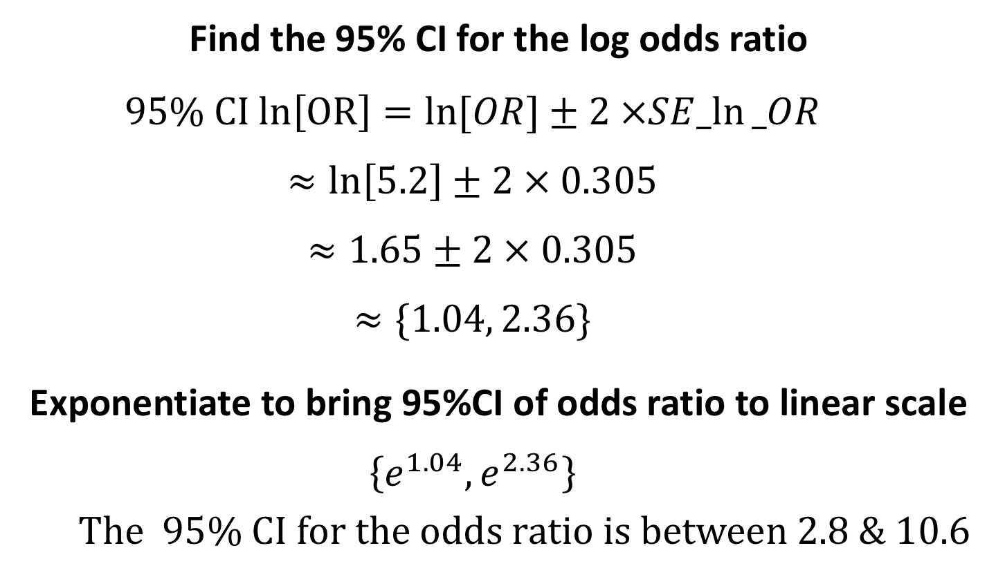
Toxoplasma & Car Wrecks: 95% CI slide 3/4
Find the 95% CI for the log odds ratio
$$95\% CI ln\left[OR\right]=\ln{[OR]}±2 ×SE_ln⁡_OR$$
$$≈\ln\left[5.2\right]±2 × 0.305$$
$$≈1.65±2 × 0.305$$
$$≈\{1.04, 2.36\}$$
Exponentiate to bring 95%CI of odds ratio to linear scale
$$\left\{e^{1.04}, e^{2.36}\right\}$$
The 95% CI for the odds ratio is between 2.8 & 10.6

Slide 20
Toxoplasma & Car Wrecks: 95% CI slide 4/4
The odds of getting in an accident are plausibly between 2.8 and 10.6 times higher for people with toxoplasma compared to those without.
This 95% CI does not contain 1.
We reject the null hypothesis and conclude that car accidents & toxoplasma are associated*.
*WARNING: correlation does not necessarily equal causation.

Slide 21
Testing Associations Between
Categorical Variables
$$\text{χ}\text{2} \text{Contingency} \text{Tests}\text{, }\text{Fisher}\text{’}\text{s} \text{Exact} \text{Test}\text{, }\text{and} \text{G}\text{−}\text{Tests}$$

Slide 22
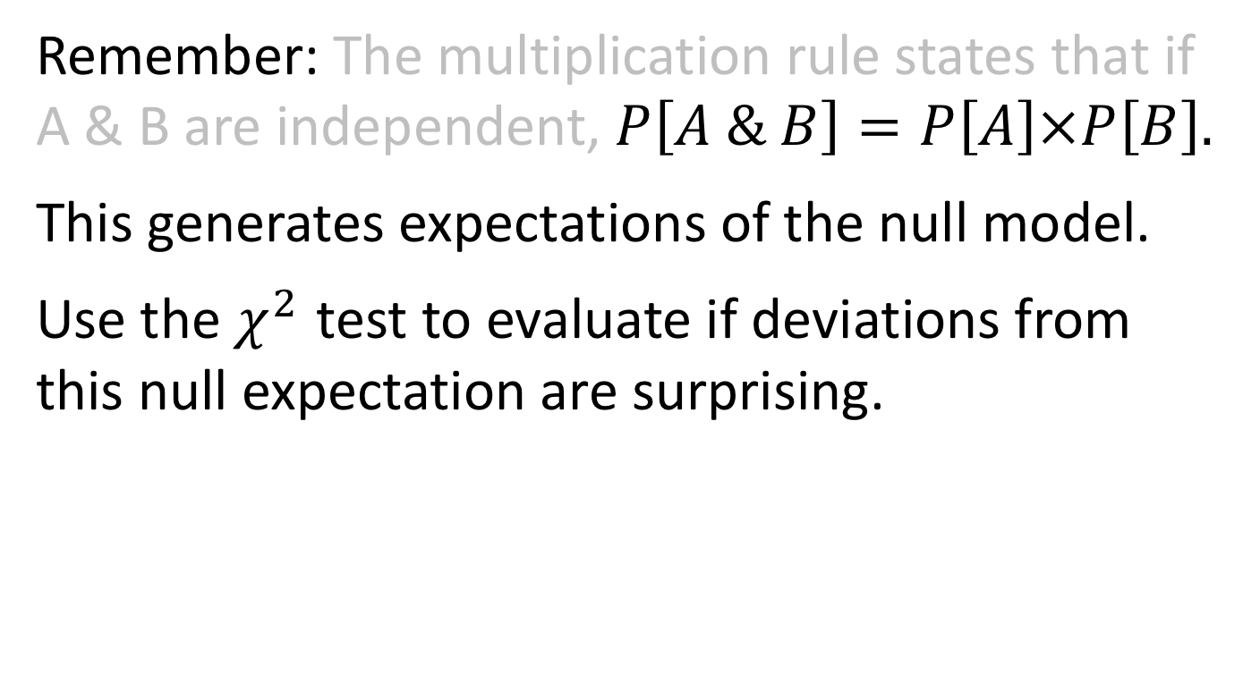
χ² Contingency Test of Independence
Remember: The multiplication rule states that if A & B are independent, $P\left[A \& B\right]=P\left[A\right]×P\left[B\right].$
This generates expectations of the null model.
Use the $χ^{2}$ test to evaluate if deviations from this null expectation are surprising.

Slide 23
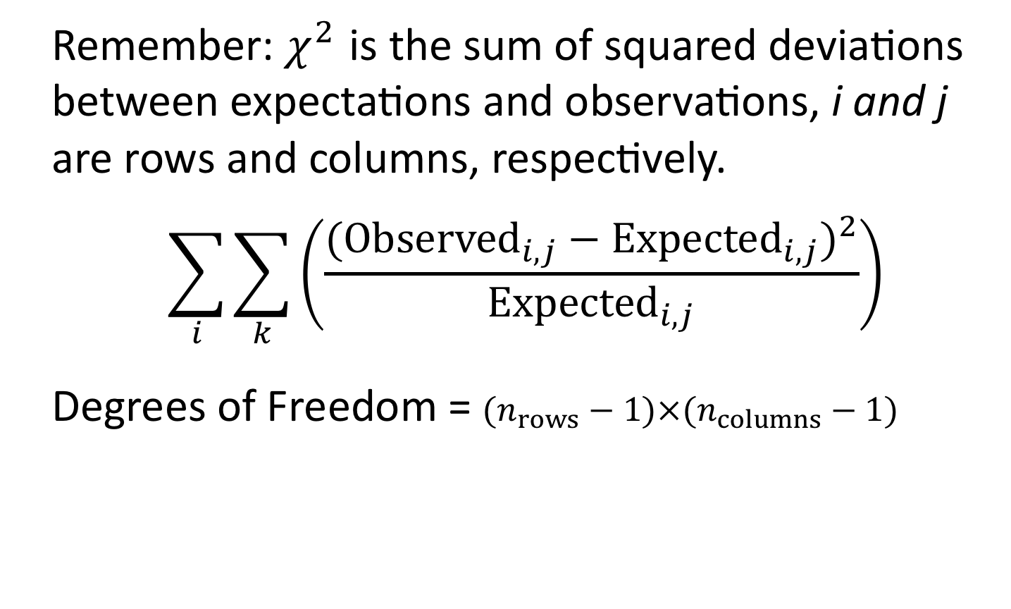
Calculating χ² & Degrees of Freedom
Remember: $χ^{2}$ is the sum of squared deviations between expectations and observations, i and j are rows and columns, respectively.
$$\sum_{i}{\sum_{k}^{ }{\left(\frac{({Observed}_{i,j}−{Expected}_{i,j})^{2}}{{Expected}_{i,j}}\right)}}$$
Degrees of Freedom = $(n_{rows}−1)×(n_{columns}−1)$

Slide 24
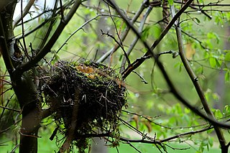
Example: Abandonment Issues
What’s a bird to do when the rent is due and they can’t feed their chicks?
Kloskowski tested the idea that birds in poor habitats abandon their final egg.
https://upload.wikimedia.org/wikipedia/commons/thumb/3/36/Abandoned_Nest_%28150169677%29.jpeg/320px-Abandoned_Nest_%28150169677%29.jpeg

Slide 25
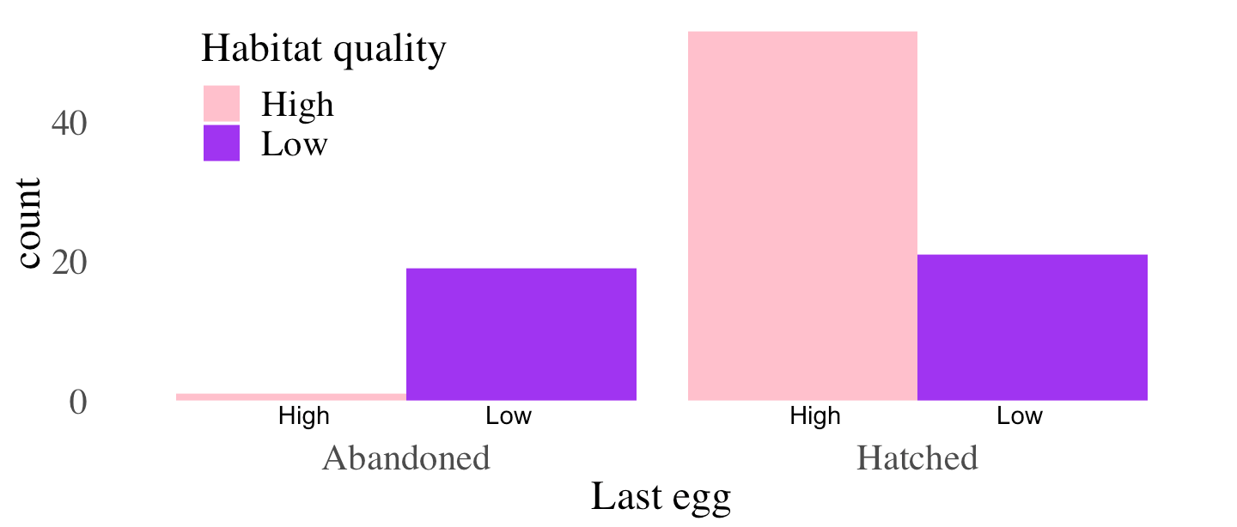
Abandonment: Plot
Association between habitat quality & the proportion of last eggs abandoned. [from Kloskowski]

Slide 26

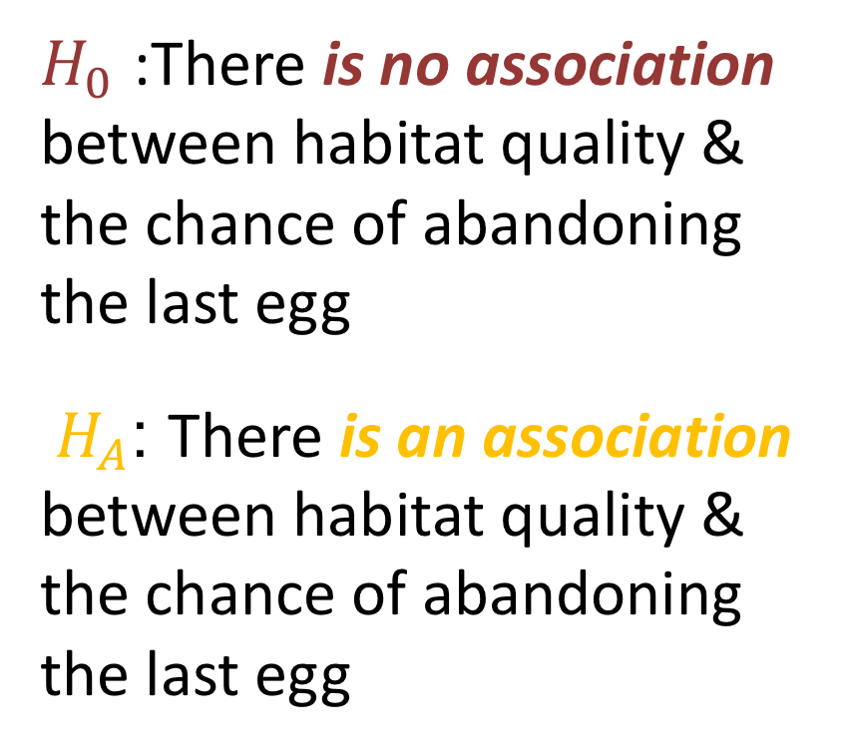
Abandonment: Hypotheses
$H_{0}$ :There is no association between habitat quality & the chance of abandoning the last egg
$H_{A}$: There is an association between habitat quality & the chance of abandoning the last egg

Slide 27
Abandonment: Observations
 | Habitat | Last Egg | Obs. | n _{Habitat} | n _{Egg}
 | Good | Abandoned | 1 | 54 | 20
 | Good | Hatched | 53 | 54 | 74
 | Bad | Abandoned | 19 | 40 | 20
 | Bad | Hatched | 21 | 40 | 74

Slide 28
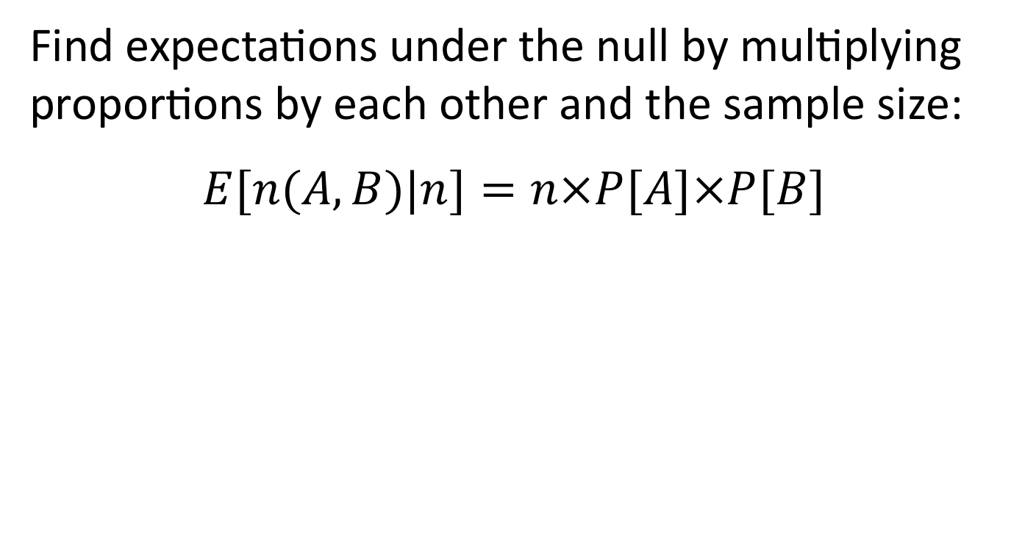
Abandonment: Null Expectations
Find expectations under the null by multiplying proportions by each other and the sample size:
$$E[n(A,B)|n]=n×P[A]×P[B]$$
 | Habitat | Last Egg | Obs. | P _{Habitat} | P _{Egg} | n_{total} | Expected
 | Good | Abandoned | 1 | 0.57 | 0.21 | 94 | 11.5
 | Good | Hatched | 53 | 0.57 | 0.79 | 94 | 42.5
 | Bad | Abandoned | 19 | 0.43 | 0.21 | 94 | 8.5
 | Bad | Hatched | 21 | 0.43 | 0.79 | 94 | 31.5

Slide 29
Abandonment: χ² Assumptions?
Remember the assumptions
Fewer than 20% of categories with Expected < 5
No category with Expected ≤ 1
We meet assumptions of the χ² test
 | Habitat | Last Egg | Obs. | P _{Habitat} | P _{Egg} | n_{total} | Expected
 | Good | Abandoned | 1 | 0.57 | 0.21 | 94 | 11.5
 | Good | Hatched | 53 | 0.57 | 0.79 | 94 | 42.5
 | Bad | Abandoned | 19 | 0.43 | 0.21 | 94 | 8.5
 | Bad | Hatched | 21 | 0.43 | 0.79 | 94 | 31.5

Slide 30
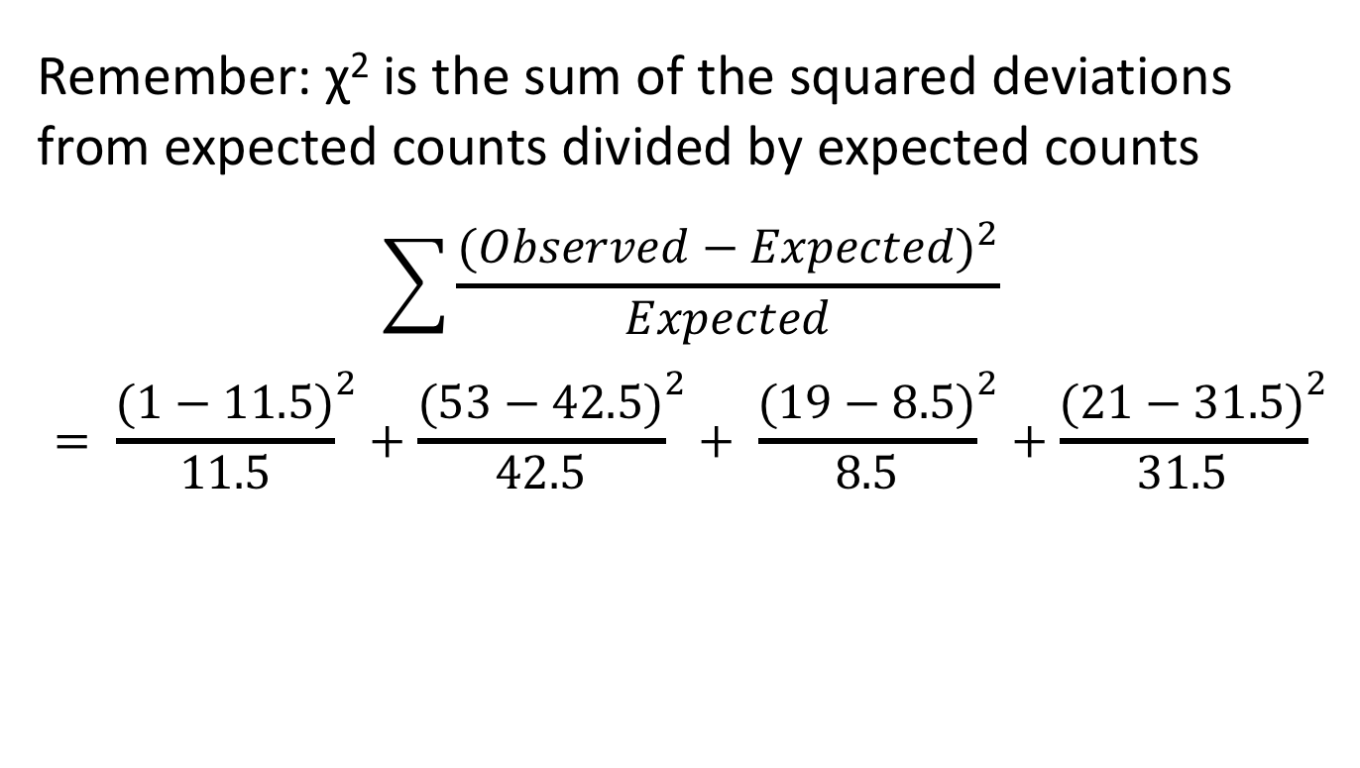
Abandonment: χ² slide 1/2
Remember: χ² is the sum of the squared deviations from expected counts divided by expected counts
$$\sum{\frac{{(Observed−Expected)}^{2}}{Expected}}= {\frac{(1−11.5)}{11.5}}^{2}+{\frac{(53−42.5)}{42.5}}^{2}+ {\frac{(19−8.5)}{8.5}}^{2}+{\frac{(21−31.5)}{31.5}}^{2}$$
 | Good Abandoned | Good Hatched | Bad Abandoned | Bad Hatched
Observed | 1 | 53 | 19 | 21
Expected | 11.5 | 42.5 | 8.5 | 31.5

Slide 31
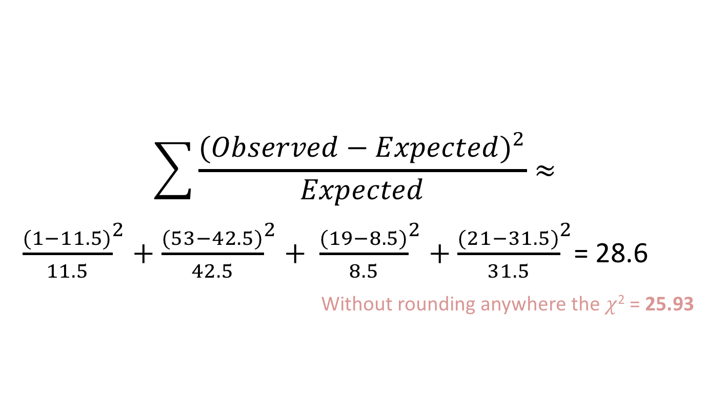
Abandonment: χ² slide 2/2
$$\sum{\frac{{(Observed−Expected)}^{2}}{Expected}}≈$$
${\frac{(1−11.5)}{11.5}}^{2}+{\frac{(53−42.5)}{42.5}}^{2}+ {\frac{(19−8.5)}{8.5}}^{2}+{\frac{(21−31.5)}{31.5}}^{2}$= 28.6
Without rounding anywhere the $χ$² = 25.93
R code (in the tidyverse)
birds.chi <- birds.summary %>%
mutate(sqd.dev = (obs – expect)^2 / expect %>%
summarise(chi2 = sum(sqd.dev))

Slide 32
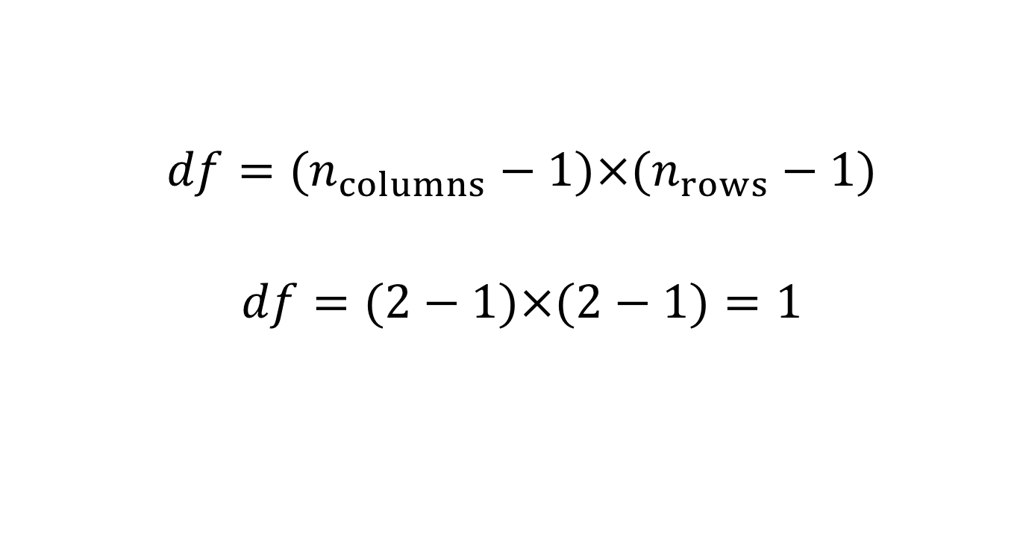
Abandonment: Degrees of Freedom
$$df=(n_{columns}−1)×(n_{rows}−1)$$
$$df=(2−1)×(2−1)=1$$

Slide 33
Abandonment: Critical & P-values slide 1/2
Recall 𝜒²=25.93 & 𝑑𝑓=1.
Critical value for degrees of freedom and alpha level in columns
Significant at the 1𝑒−7 level‼️. Reject the 𝐻₀
 | 10⁻¹ | 10⁻² | 10⁻³ | 10⁻⁴ | 10⁻⁵ | 10⁻⁶ | 10⁻⁷ | 10⁻⁸
df = 1 | 2.7 | 6.6 | 10.8 | 15.1 | 19.5 | 23.9 | 28.4 | 32.8
df = 2 | 4.6 | 9.2 | 13.8 | 18.4 | 23.0 | 27.6 | 32.2 | 36.8

Slide 34
Abandonment: Critical & P-values slide 2/2
Recall 𝜒²=28.59 & 𝑑𝑓=1.
Critical value for degrees of freedom and alpha level in columns
Significant at the 1𝑒−7 level‼️. Reject the 𝐻₀
Conclude that bird abandon eggs in bad environments.
(The exact p-value = 8.96e-08)
 | 10⁻¹ | 10⁻² | 10⁻³ | 10⁻⁴ | 10⁻⁵ | 10⁻⁶ | 10⁻⁷ | 10⁻⁸
df = 1 | 2.7 | 6.6 | 10.8 | 15.1 | 19.5 | 23.9 | 28.4 | 32.8
df = 2 | 4.6 | 9.2 | 13.8 | 18.4 | 23.0 | 27.6 | 32.2 | 36.8

Slide 35
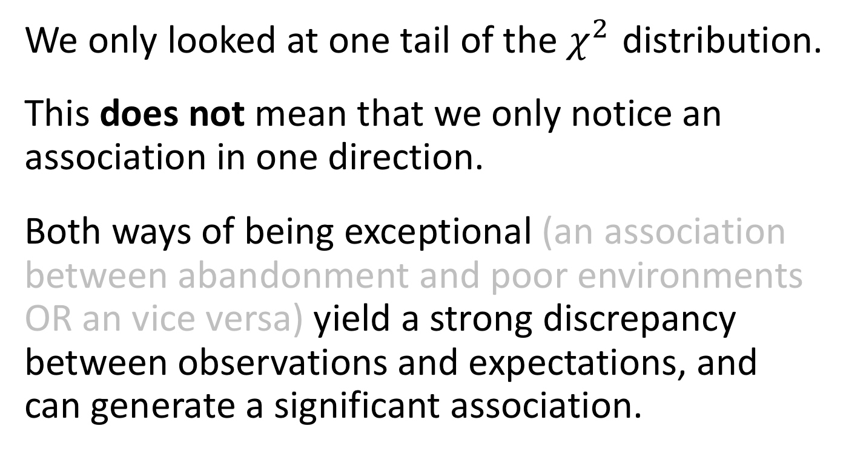
One Tailed Test?
We only looked at one tail of the $χ^{2}$ distribution.
This does not mean that we only notice an association in one direction.
Both ways of being exceptional (an association between abandonment and poor environments OR an vice versa) yield a strong discrepancy between observations and expectations, and can generate a significant association.

Slide 36
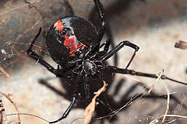
Example: Nuptial Gifts
Sometimes female Latrodectus hasselti (redback spiders) eat their mates. Is there anything in it for the males?
Maydianne Andrade tested the idea that eating a male might prevent her from re-mating with a second male.
https://upload.wikimedia.org/wikipedia/commons/thumb/6/6a/Red_back_underside.jpg/240px-Red_back_underside.jpg
Andrade, M. 1996. Science 271: 70-72 Link

Slide 37
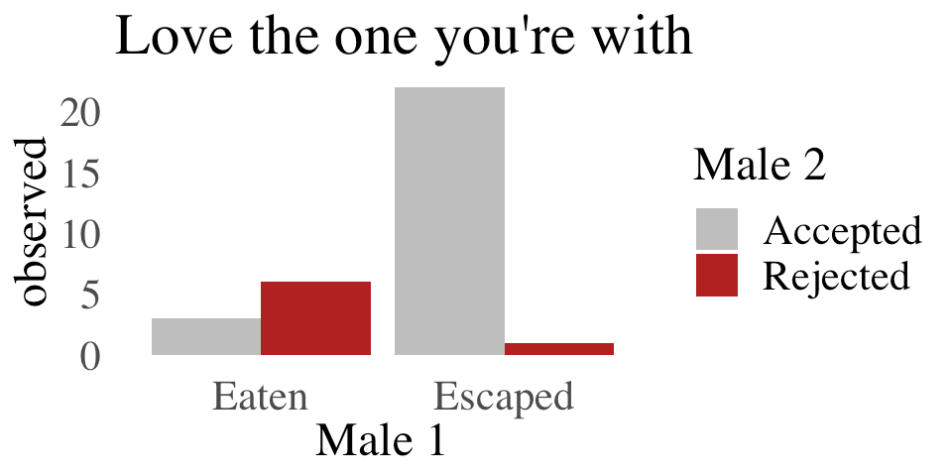
Nuptial Gift: Observed & Expected
 | 1st Male | 2nd Male | Observed | p_{Male1} | p_{Male2} | Expected
 | Eaten | Accepted | 3 | 0.28 | 0.78 | 7.03
 | Eaten | Rejected | 6 | 0.28 | 0.22 | 1.97
 | Escaped | Accepted | 22 | 0.72 | 0.78 | 17.97
 | Escaped | Rejected | 1 | 0.72 | 0.22 | 5.03

Slide 38
Nuptial Gift: χ² Assumptions?
Remember the assumptions
Fewer than 20% of categories with Expected < 5
No category with Expected ≤ 1
We do not meet the assumptions

Slide 39
The Fisher’s Exact Test
An alternative to χ² contingency test.
Makes no assumptions about cell sizes.
Generates all possible permutations.
Finds the proportion of permutations as or more extreme than observed.
fisher.test(spiders) # R code
P-value = 0.0006 Odds Ratio = 0.0279 95% CI {5e-4 , 0.3297}
We reject the null hypothesis.
Females are less apt to re-mate after eating their mate.

Slide 40
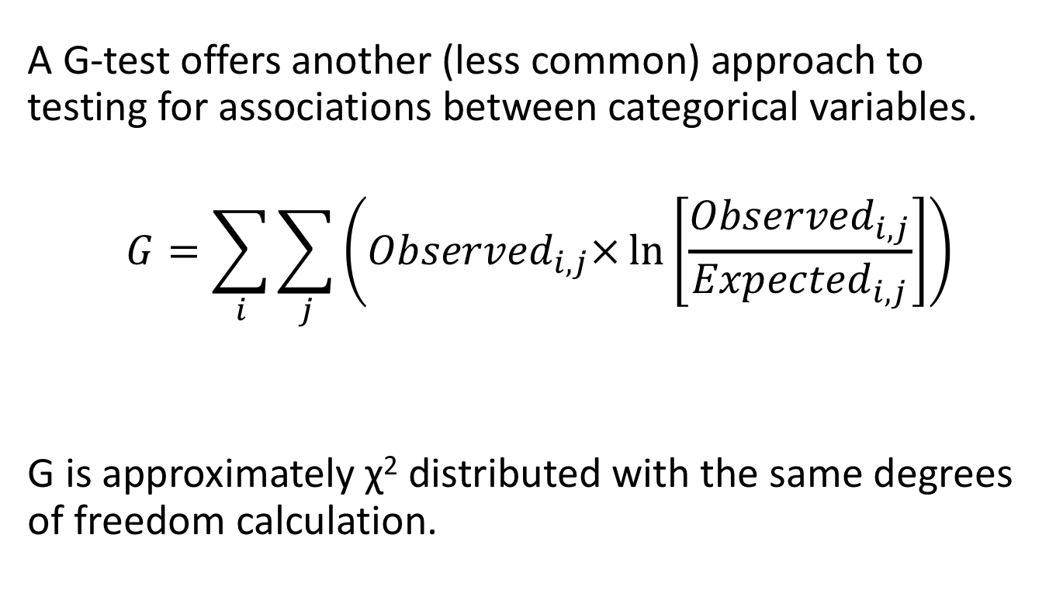
G-tests
A G-test offers another (less common) approach to testing for associations between categorical variables.
$$G=\sum_{i}{\sum_{j}^{ }{\left({Observed}_{i,j}×\ln\left[\frac{{Observed}_{i,j}}{{Expected}_{i,j}}\right]\right)}}$$
G is approximately χ² distributed with the same degrees of freedom calculation.

